Slide 1
Recycling & Composting symbols
Part 1 Recycling

Slide 2
On pack symbols
The on-pack recycling labels are the key to understanding the recycling route for packaged products.
This presentation gives a quick guide to the symbols that are the key to waste and resource management.

Slide 3

Pay to pollute?
This symbol shows that the producer has made a contribution (financial?) to the recovery and recycling of packaging.
The Green Dot does not mean that the packaging is recycled or recyclable.
Trademark of PRO Europe – Packaging Recovery Organisation Europe

Slide 4

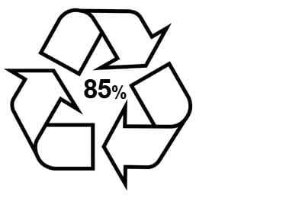
MOBIUS LOOP
Three green arrows going in a triangle simply means that it's capable of being recycled.
The symbol may come with a percentage in the middle, signifying how much of it has been made from recycled materials.

Slide 5
General Signage
Symbols for separating materials

Slide 6
Biodgradable
The American Society for Testing and Materials (ASTM) defines biodegradables as:
Anything that undergoes degradation resulting from the action of naturally occurring microorganisms such as bacteria, fungi, and algae within a reasonably short period of time after customary disposal”, as indicated by reliable scientific evidence.

Slide 7

Glass
This symbol reminds people to recycle the glass container.
Dispose of glass bottles and jars using your glass household recycling collection or a bottle bank, remembering to separate colours.

Slide 8

Recyclable aluminium
This symbol indicates that the item is made from recyclable aluminium.
FOIL IS WIDELY RECYCLED
Clean household foil and aluminium trays are widely recycled in household collection schemes and at recycling points.

Slide 9

Recyclable steel
This symbol means that the product is made of steel.
All local authorities collect steel cans for recycling.
Other steel or metal items can be taken to your household recycling centre.

Slide 10
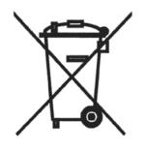
Waste electricals
Electrical item should not be added to in the general waste. Electrical items can be recycled through a number of channels..
Some local authorities collect small electrical items as part of their kerbside collection, They can also be recycled via selected retailers and at Household Waste Recycling Centres.

Slide 11
New Plastic Materials
A large number of new plastic materials have been launched recently but some may not be as good as we are led to believe.
Not all these new materials can be home composted or recycled via kerbside collections in all areas of the UK, including Leicestershire.

Slide 12

Plastics
Three arrows in a triangle means that the item is capable of being recycled. The numbers and letters act as identification for the recycling teams.
Plastics are classified into one of seven categories, each one a different material that is more or less easy to recycle.
1 = PET, Polyethylene Terephthalate is widely recycled. (cont)

Slide 13
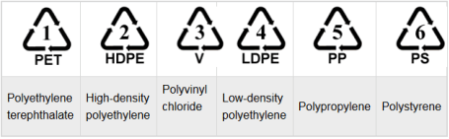
Plastic Packaging
A variety of materials are used in plastic packaging depending on the intended use.
Although the three black arrows or Mobius loop suggest recyclability this may be the case as the film may have multiple layers of material laminated together.
The triangle symbols indicate plastic material with the number inside relating to the resin used to make the packaging.

Slide 14
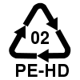


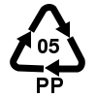

Plastics (cont)
2. High-Density Polyethylene, and widely recycled.
3 = PVC, Polyvinyl Chloride, can be recycled but harder to do so, so check with LA.
4 = LDPE, Low-Density Polyethylene, also capable of being recycled, but check LA.
5 = PP, Polypropylene, hard or not possible to recycle. Reuse or avoid.
6 = PS, Polystyrene or Styrofoam, hard or not possible to recycle,
7 = other. Usually a mix of different plastics and is difficult to recycle.

Slide 15
Recycling symbols
On pack symbols

Slide 16
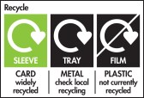
General Recycling symbols
Other more general recycling symbols pictured right were first introduced in the UK as part of the on-pack recycling label scheme to help consumers understand which materials are recyclable.

Slide 17


RECYCLING SYMBOLS
Widely Recycled
This label is applied to packaging
that is collected by 75% or more of local authorities
Widely Recycled - Rinse
Rinsing packaging, e.g. food trays, so that any food residue doesn’t contaminate other materials

Slide 18

RECYCLING SYMBOLS 2
Widely Recycled - Rinse, Lid On
Glass jars etc. should be rinsed and the lids
replaced even though the lid of the jar might
be metal.
This prevents small metal lids falling through
holes designed to remove contamination during sorting. The metal is separated from the glass by the glass recyclers and goes off to be recycled elsewhere.

Slide 19

Widely Recycled - Flatten, Cap On
Widely Recycled - Flatten
Used on plastic bottles and drinks cartons.
Flattening gives more space in the recycling bin.
Replacing the caps helps to keep them flat.
Widely Recycled- Cap On
Used on plastic bottles. Small caps fall through
the holes in the sorting process, keeping the cap on means that all of the packaging will can be recycled. With mixed recycling is it a helps to prevent other materials, particularly glass, getting stuck inside the bottles.

Slide 20
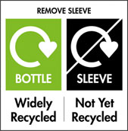
Bottle - Widely Recycled, Sleeve - Not Yet Recycled
Remove sleeve –e.g. a paper sleeve that wrapped around a large Yoghurt pot can be removed and recycled
with paper.
Sometimes the sleeves are not recyclable and
therefore the instruction is to remove the sleeve
and put it in the waste bin.
If it doesn’t say either way, it can probably be left on to be removed during the recycling process.

Slide 21


Widely Recycled at Recycling Centres
Widely Recycled at Recycling Centres
Metal paint cans can be recycled at recycling centres. Some will also take cans containing paint. Check with your local council
Widely Recycled at Recycling Points:
Check Locally for Kerbside
Food and drink cartons
Food and drink cartons, e.g. Tetra Paks are collected by many local authorities and/or can also be recycled at many recycling centres

Slide 22

Recycle with Bags at Larger Stores
Some Plastic film, wrap and bags (PE)
can be recycled at supermarket's carrier bag collection points.
Found on some breakfast cereal, toilet and kitchen roll wraps, bread bags, grocery produce, multipack shrink wrap and newspaper and magazine wraps.
Check Locally for Kerbside
Some may be collected at kerbside

Slide 23
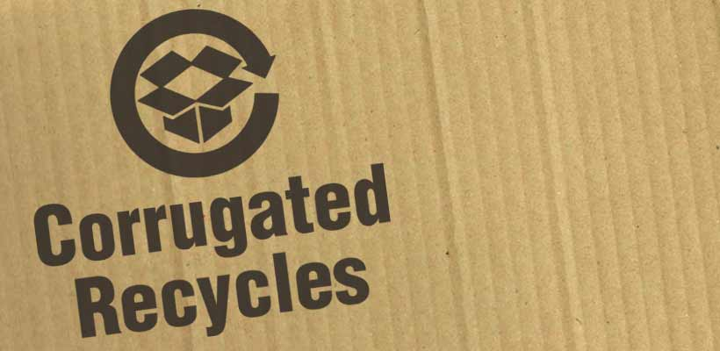
Corrigated cardboard
Used on corrugated containers.
It does not indicate that the packaging is manufactured from recycled material, but rather means that the pack could (and should) be recycled.
Developed by the International Corrugated Case Association

Slide 24

RESY corrugated cardboard
German recycling scheme that guarantees that packaging is recyclable
The RESY (GmbH) licensed symbol is used on transit packaging manufactured from corrugated cardboard
Widely used in Germany, frequently used in the UK..

Slide 25


Not Yet Recycled
This label is applied to packaging when less than 20% of local authorities collect it across the UK, for example crisp packets.
Check Locally
This label is applied to packaging that is collected by 20-75% of local authorities across the UK, for example some types of plastic packaging

Slide 26
Part 1
The end
Part 2 covers
Composting & Biodegradation
Symbols

Slide 27
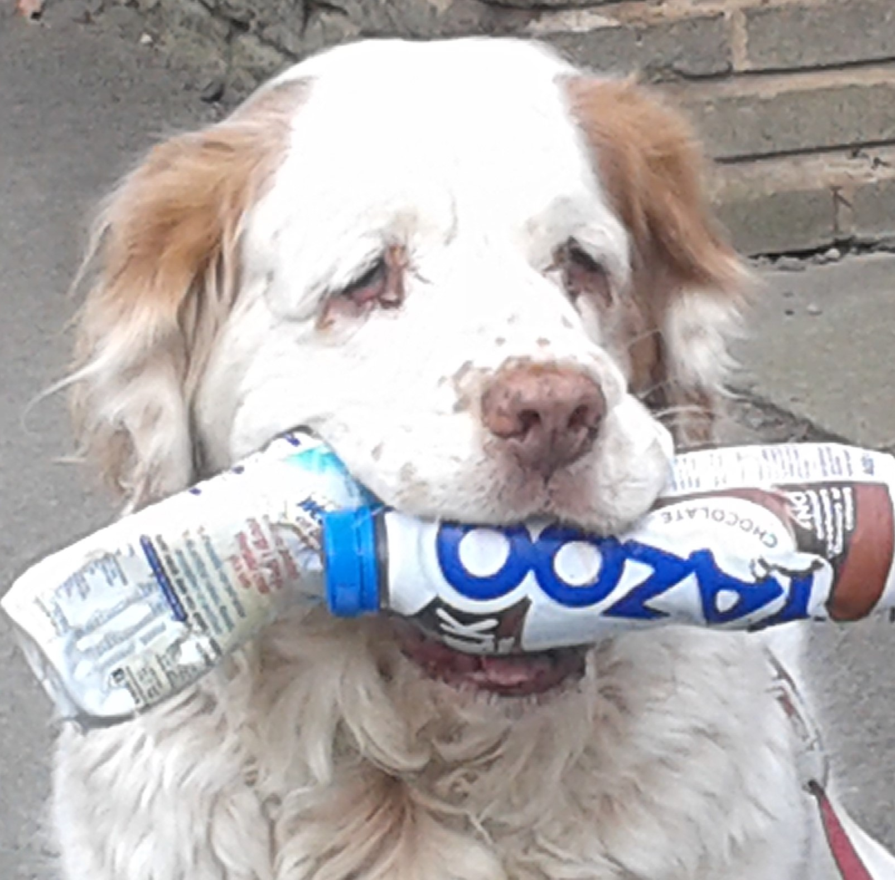
Part 1
The End
Both parts of this presentation can be downloaded from ww.carryoncomposting.com

