Slide 1
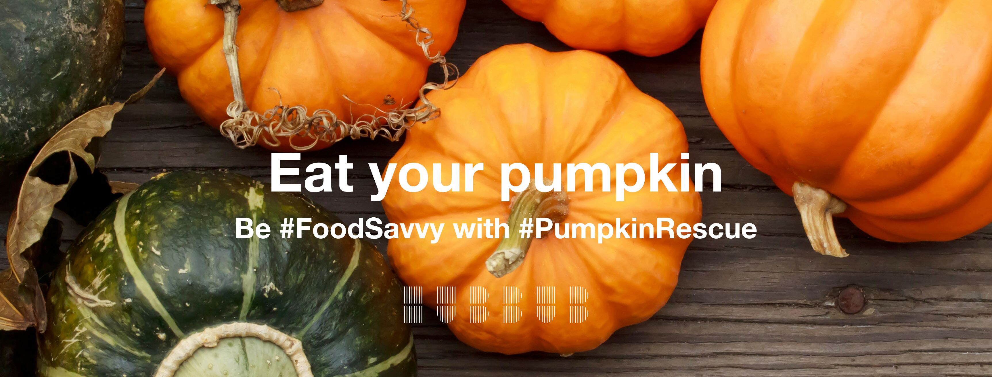
Leicester & Leicestershire Pumpkin Rescue
2019
www.Carry on Composting. com

Slide 3
Organise or take part in a Pumpkin Rescue Food Event
Provide pumpkin recipes and cooking advice to the public, clubs and schools.
Organise cookery demonstrations
Book a place on the Pumpkin Lunch and bring a pumpkin dish to share at Stokes Wood Allotment Pavilion
Restaurants, cafes and pubs. Put pumpkin dishes on the menu and promote them via our network
Ask your favourite eatery to participate
wood and bring a pumpkin dish to share Best Carved pumpkin judging at Stokes Wood Allotment Pumpkin Smash at Stokes Wood Allotment Compost Demonstration Site Take part in the smashing of the carved pumpkins and start composting them

Slide 4
Carved Pumpkins
It is estimated that in the UK up to four million
pumpkins are brought to carve and display over
Halloween with the edible flesh of these pumpkins being discarded as waste
This produces an additional 18,000 tons of landfill waste directly attributable to the Halloween festivities.
According to the environmental charity Hubbub, this is equivalent to 360 million portions of pumpkin pie.

Slide 5
Activities: Join us in reducing pumpkin waste while celebrating Halloween
Provide pumpkin recipes and cooking advice
Pumpkin Smash at Stokes Wood Allotment Compost Demonstration Site Take part in the smashing of the carved pumpkins and start composting them

Slide 6
Activities: Hold a best carved pumpkin competition
Organise a carved pumpkin event and photograph the pumpkins and carvers in your Community Centre or school before sending them to Stokes Wood Allotment for display and judging. Encourage carvers to cook the flesh from the pumpkins
Judge the competition award the prizes.
Take photos for the press. Stress the need to reduce waste.
Collect the carved pumpkins after Halloween and organize a “Pumpkin Smash”

Slide 7
Pumpkin Faces
Where young children may not be able to carve a pumpkin they can draw a face on it to make a pumpkin head

Slide 8
ACTIVITIES: Biggest Pumpkin competitions
The fresh of giant pumpkins grown for Biggest Pumpkin Competitions is also edible but tends to be coarser and have less flavour than pumpkins grown specifically to eat.
They can still be used in pies, soups, and
in recipes as an alternative for squash.
These can be donated to hospitals
residential homes etc.
As with other pumpkins the skins can
be composted.

Slide 9
Joi us in reducing pumpkin waste while celebrating Halloween

Slide 10
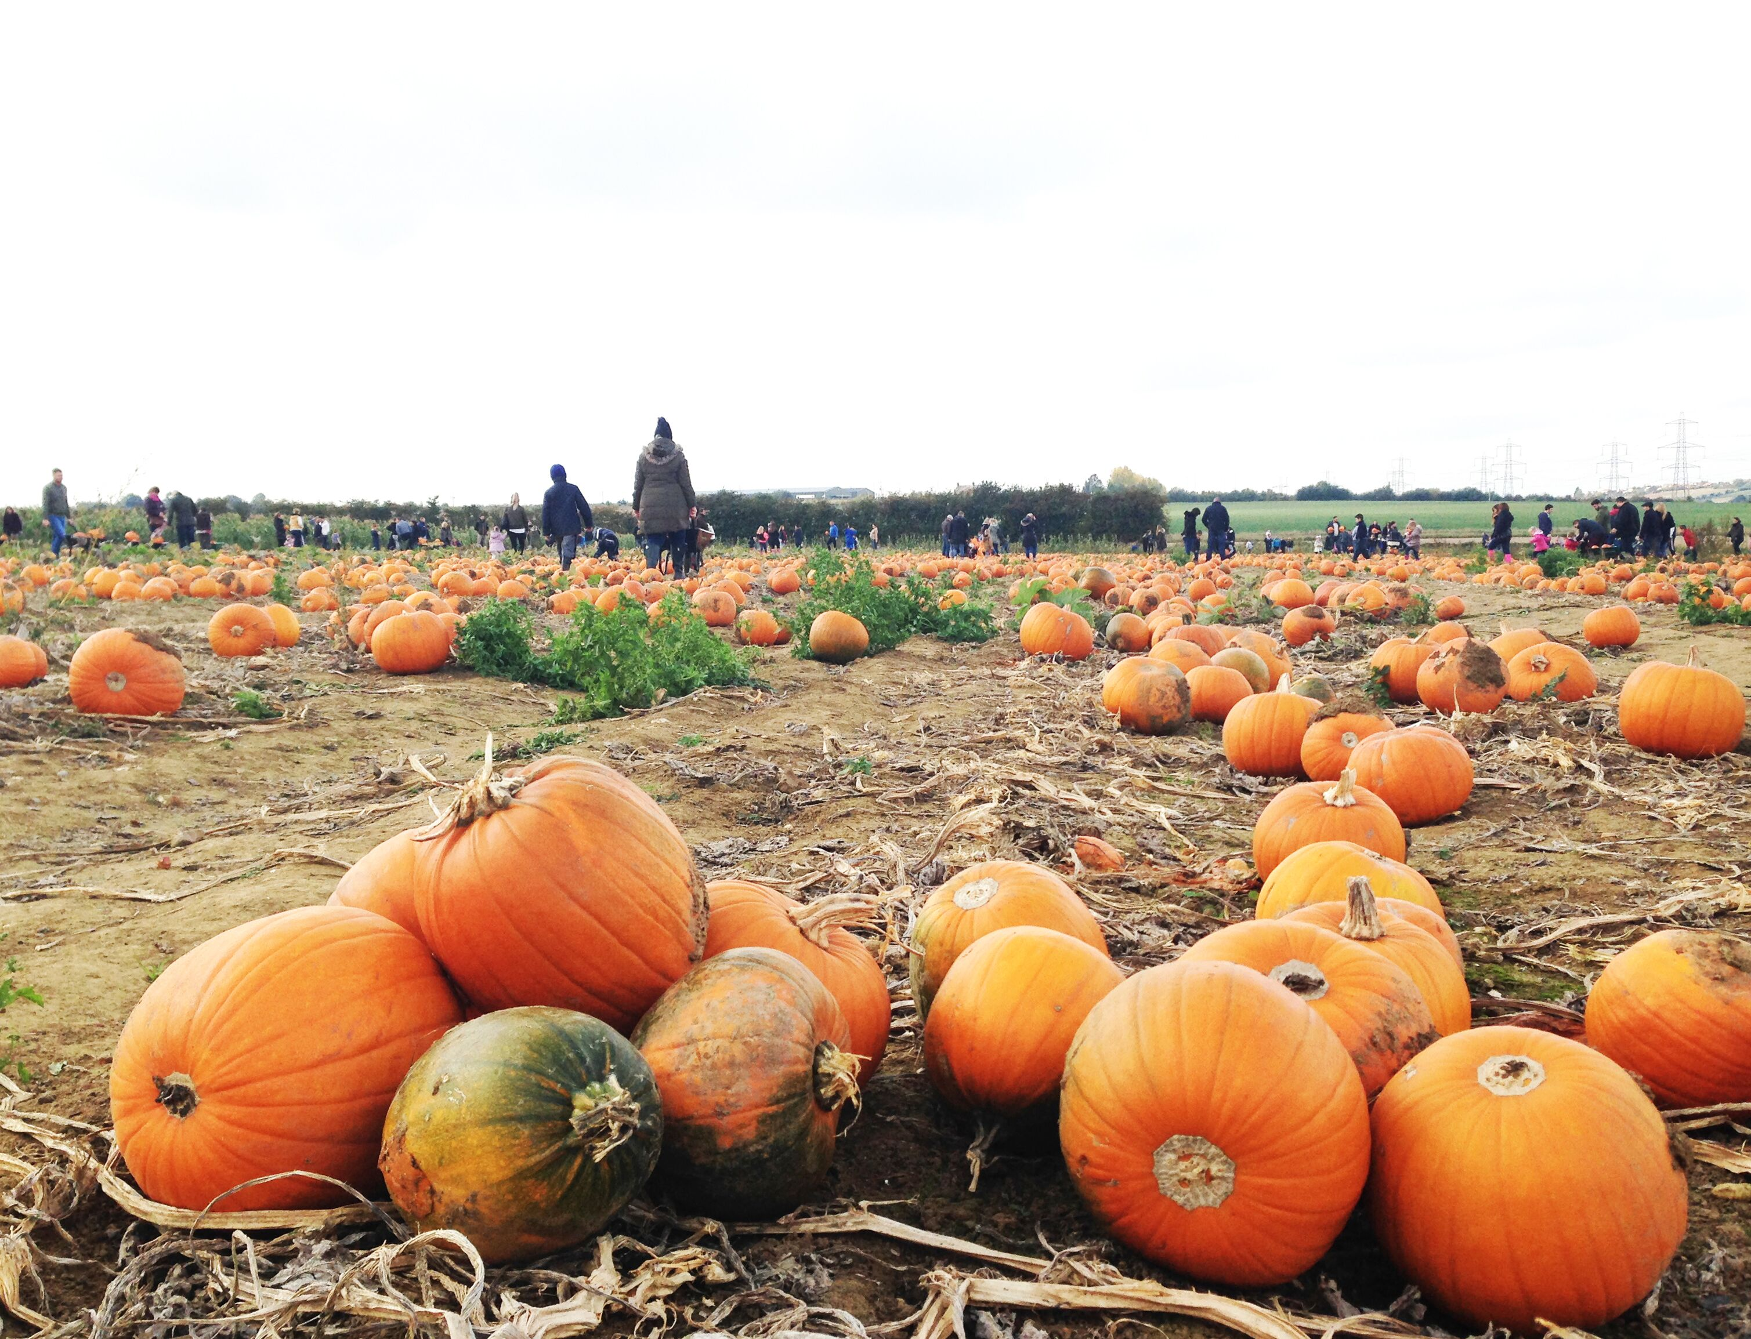
Cook Pumpkin Carvings
It is calculated that in the UK only 33% cook the fresh of the pumpkins they carve out.
On this basis, farmers are growing acres of food just for it to be thrown away

Slide 11
Recipes for squashes and pumpkins
Pumpkin Recipes 1
Love Food Hate Waste
(http://ni.lovefoodhatewaste.com/node/4172)
publishes a range of pumpkin recipes such as
Gnocchi in Pumpkin and Chilli Sauce,
Pumpkin & Butter Bean Broth, Pumpkin ravioli,
Pumpkin Tart, Roasted Pumpkin, Roast Pumpkin Lasagne and Coriander Soup.
Pumpkin seeds, when toasted or baked, are rich in potassium and protein.
Over 650 recipes using pumpkins can be found at allrecipes.com including pumpkin burgers.

Slide 12
More Pumpkin Recipes 2
Recipes From (34) savoury soups to sweet treats
https://www.bbcgoodfood.com/recipes/collection/pumpkin
60 Pumpkin Recipes for Delicious Fall Dinners
https://www.countryliving.com/food-drinks/g619/our-best-pumpkin-recipes-1008/
Over 500 sweet and savoury recipes pumpkin recipes for everything from pumpkin cake and pie to roast pumpkin and pumpkin soup.
http://allrecipes.co.uk/recipes/tag-261/pumpkin-recipes.aspx

Slide 13
Activities: Pumpkin Smash
Schools and allotments can collect carved pumpkins from their locality and hold a smash to compost on site
Or they could act as a collection point for them to taken to Stokes Wood allotment for a “Smash” on 9th November
Or for collection by the council

Slide 14
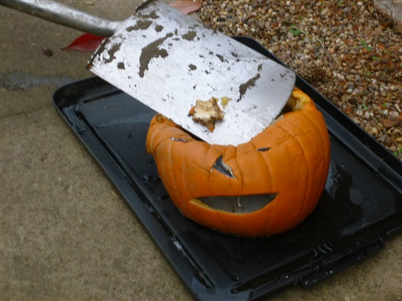
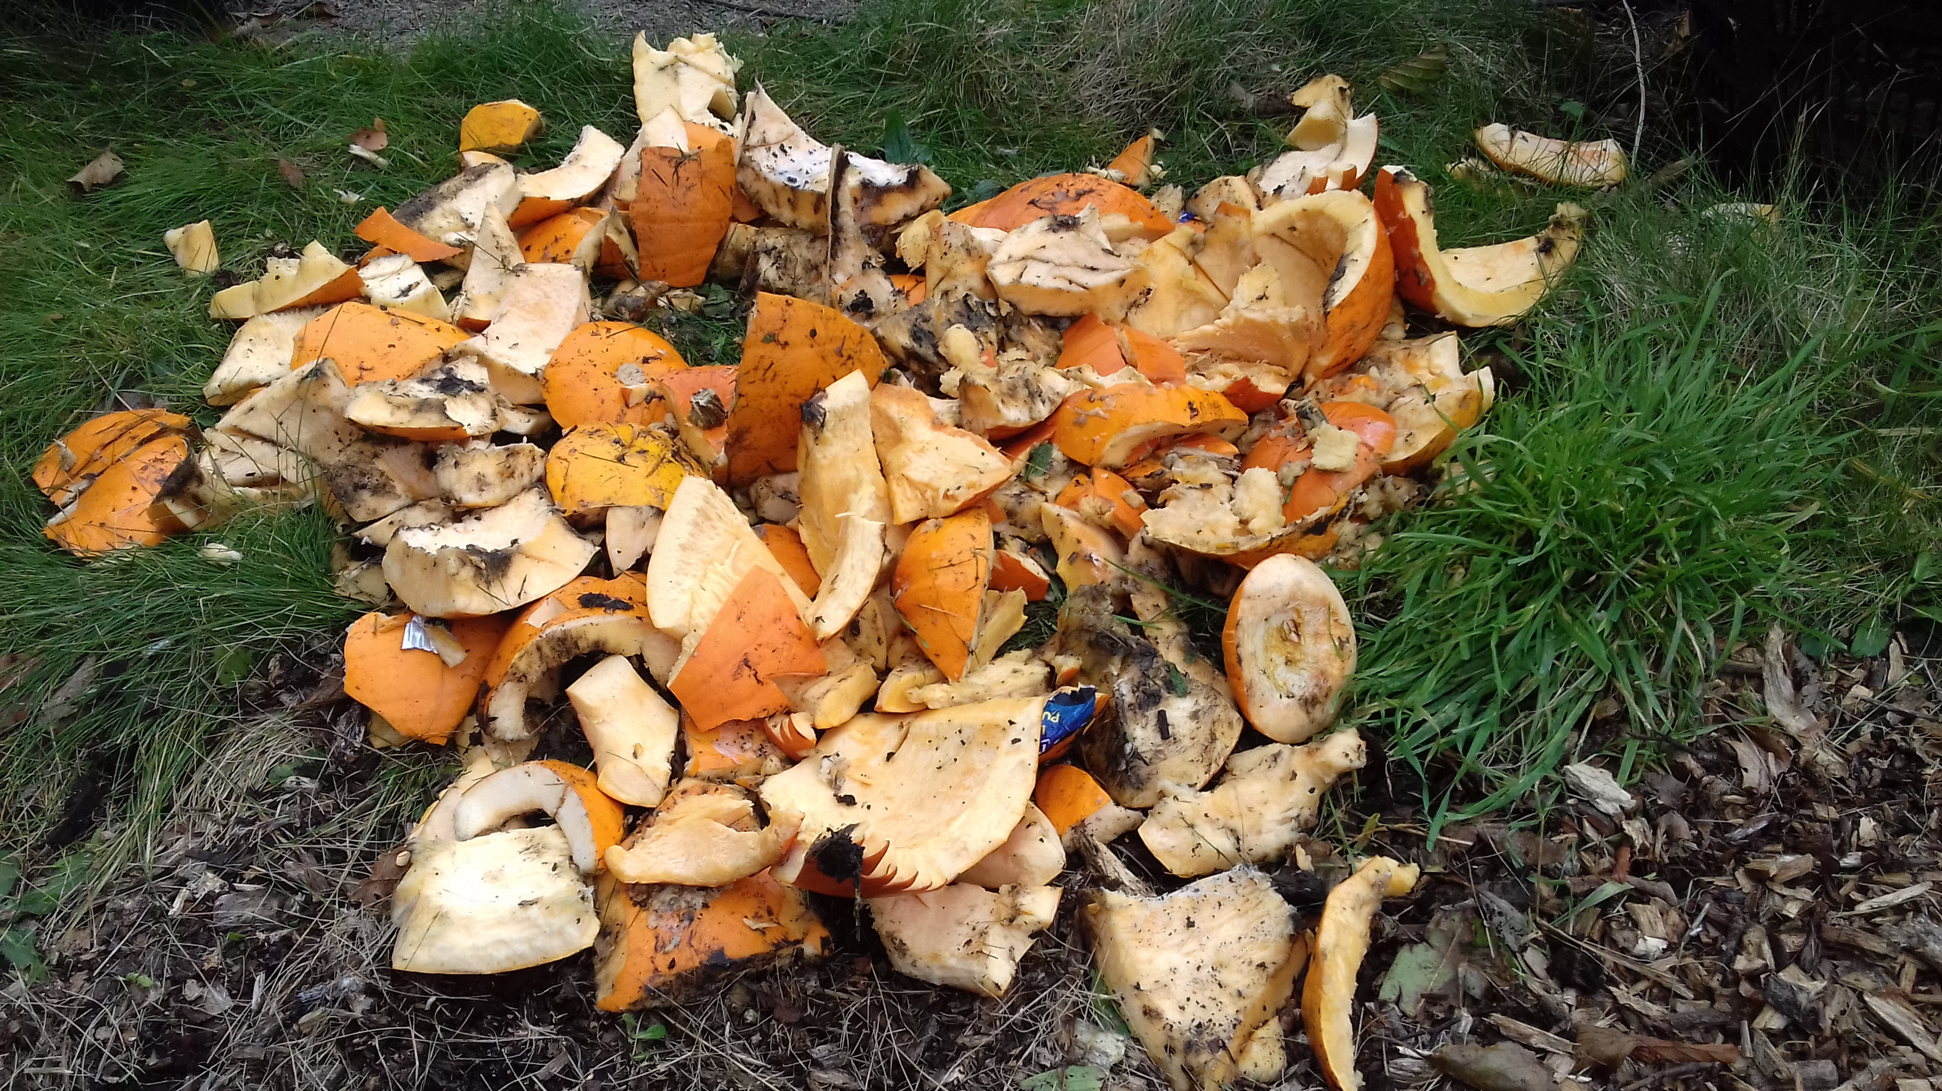
Pumpkin Smash
Cut the pumpkins into pieces using a spade of kitchen knife (adults only)

Slide 15
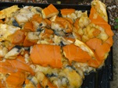
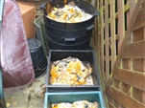
Composting Pumpkins
Smashed pumpkins added to wormeries

Slide 16
Pit or Trench Composting Pumpkins
The simplest way to compost carved pumpkins in a pit or trench.
. Find a sunny spot in the garden which will not be disrupted until the next summer, dig out a shallow pumpkin grave about a spit deep make a bed of vegetable leaves, peelings and other compostable materials in the bottom place the pumpkin in the middle and smash it.
If a large number of pumpkins are available e.g. from a club, village or school carved pumpkin competition a shallow trench can be dug, and the pumpkins spread along it to be smashed in situ or they can be smashed on an old compost bag and the mush tipped into the trench.
Cover with soil or compostable materials such wood chip, sawdust or leaves. This is a variation on the traditional trench composting technique

Slide 17
Mini Windrow technique
A variation on this technique is to put the pumpkins in an old dustbin, smash it using a shovel, and then add leaves to the container mixing well before spreading in a depression in the ground.
A mini-windrow about 2” high can be built of alternate layers of hay, leaves and uncooked vegetable food waste together with cardboard and other compostable material.
The pile is then soaked with water and covered with a black polythene sheet or tarpaulin and left to decompose

Slide 18
Compost Bin or Heap
The remains of the pumpkin can be added to the compost bin.
Pumpkins are classified as Greens in composting terms being high in nitrogen and should be covered or mixed with a layer of browns, such as dry leaves, shredded paper or cardboard, to maintain the balance of Greens and Browns and to discourage flies and other pests.
However, one source suggests that pumpkin are best mixed with dried coffee grounds, another green, before being added to the bin.
Giant pumpkins can be smashed and frozen for composting. Pumpkins that rot before harvesting can also be composted.

Slide 19
Include Squashes in the Campaign
There are those who feel that squashes are more tasty than pumpkins include their skins in any collection programme

Slide 20
Keep us informed
Send news and photos to : carryoncomposting1@gmail.com
Check out the webpages at http://www.carryoncomposting.com/441149742

